Slide 1
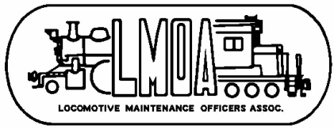

X-Ray CT Scanning of Diesel Fuel Injectors
Abstract – Industrial X-Ray Computed Tomography (CT) is a powerful nondestructive technique used to inspect internal structures and components. The resulting 3D images can be used for defect detection, metrology, foreign material detection, and other applications. This paper includes a case study in detailed inspection of GE FDL and EMD MUI diesel locomotive fuel injector tip inspections, including metrology with a resolution on the order of 10 microns, identifying and quantifying internal material loss and pitting, and identifying internal injector deposits.
Background –
Internal part inspection often involves destructive testing – having to cut parts for internal measurements.
Often gaining access to make measurements affects what you are trying to measure/quantify
  Example – deposits within the tip of a diesel fuel injector
Complex internal shapes pose challenges in metrology
Conclusion – X-ray CT is a powerful nondestructive way to visualize and quantify internal structures
Recommendation – Become familiar with X-ray CT capabilities, and add it to your diagnostic and evaluation tool kit.
Fuel, Lube, and Environmental Committee 2018

