Slide 1
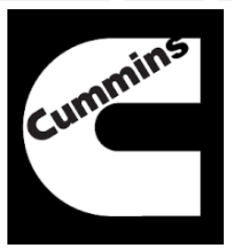
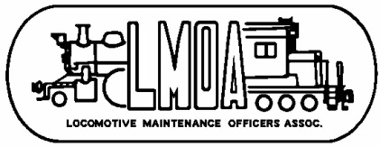
SCR Systems for Locomotive NOx Control
Abstract – T4 locomotive and maintenance of way (MOW) engines with Selective Catalytic Reduction (SCR) are increasingly being placed into service
  Mainly in new passenger locomotives and MOW equipment
  Also appearing in passenger locomotive repowers, high horsepower freight locomotive repowers, and switcher/medium horsepower locomotives repowers
Background –Tier 4 emission levels requires significant technology advancements, SCR is one of them
  SCR requires diesel exhaust fluid (DEF), a DEF dosing pump system, and a freeze prevention method/heating circuit for DEF storage (wayside and on application)
Conclusion – There are a handful of locomotive and MOW applications in operation today that use SCR and the numbers are increasing
Recommendation –SCR will become more prevalent in the locomotive and rail industry and adaptations will be required for handling and storing DEF, and maintaining systems
Fuel, Lube, and Environmental Committee 2018

