Slide 1
Electrical Maintenance Committee
2025
Executive Summary
Chair
Brent Brown
Vice Chair
Randy Honc

Slide 2
2025 Electrical Maintenance Roster Update
3 joined since RSI 2024
1. Gil Shoshani
2. Jim Notofrancisco
Marmon Industrial Energy & Infrastructure Group
3. Steven Romero
Wabtec
Membership
8 Railroad
27 Supplier
Notes:
Roster clean up
35 members (27 Supplier and 8 RR’s)
400+ years of experience
Two more members in que

Slide 3
2025 Activities
2024 Q4 kick off Meeting
*Virtual
Accomplishments
Paper/presentations
2025 March Planning
Goals
RSI final prep

Slide 4
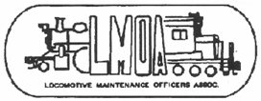
2025Papers
Enhancing Locomotive Reliability Through Auxiliary Power Integration David Caron, EkyRail; Jason Hettermann, Fugiel
Locomotive Wiring and Governing Specifications; Gil Shoshani Marmon Industrial Energy and Infrastructure
Diesel Electric AC Locomotives, Randy Honc Southwest Research; Shane Sledge Norfolk Southern
Single Pair Ethernet, Raul Huerta, Harting David Pettengill Dayton Phoenix Group

Slide 5
Enhancing Locomotive Reliability Through Auxiliary Power Integration
Overview Automatic Engine Start-Stop (AESS) systems have demonstrated significant value in reducing fuel consumption and emissions for railroads over the years. However, advancements in technology, such as Positive Train Control (PTC), have introduced additional electrical loads, leading to increased stress on locomotive batteries. This added demand has resulted in frequent re-starts due to low battery voltage thereby diminishing the operational savings initially realized by AESS implementations.
Technical Background One potential solution to mitigate these challenges involves integrating an auxiliary power source dedicated to supporting essential loads. This auxiliary system would alleviate the strain on the primary battery, ensuring consistent power availability for critical systems..
Conclusions Incorporating an auxiliary power source offers several technical benefits:
Battery Performance: Reduces the frequency of low-voltage restarts, thereby enhancing the reliability and lifespan of the locomotive’s starting battery.
System Stability: Minimizes voltage drops that could affect the main computer system, improving overall operational reliability.
AESS Optimization: Facilitates proper functioning of the AESS system, leading to sustained fuel efficiency and reduced greenhouse gas emissions.
Recommendations Further research and testing are necessary to comprehensively evaluate the implications of introducing auxiliary power systems. These studies should focus on performance metrics, cost-effectiveness, and long-term impact on locomotive operations.
Electrical Committee 2025
David Caron
(450) 692-1376
david.caron@ekyrail.com

Slide 6
Locomotive Wiring and Governing Specifications
Abstract
USA/Canada Locomotive Wiring are rated at 125°C insulation and they follow AAR RP-585/S501 specifications.
The wires are tested to a set of rigorous Electrical, Mechanical and Physical tests outlined in the specification to guarantee at least 20 years cable service life.
Background
S501 (1983) was the first AAR locomotive wiring specification, it was changed in 2001 to AAR RP-585.
AAR RP-585 specifies class I Tin Copper conductor and a Cross-Linked Polyolefin insulation for 600V and 2000V wiring.
Conclusion
North America locomotive manufacturers have been using this wire technology since the 1970’s with no known failures. The wire is used for all 600V and 2000V applications including Lockers, Cabinets and Traction Motor Leads.
Full details will be discussed at the Spring 2025 Convention in Indianapolis.
Recommendation
AAR RP-585 wire qualification proved itself in the North America Locomotive market for flexibility and reliability. Additional Flame, Smoke and Toxicity (FST) like NFPA 130 (Flame and Smoke), ASTM E662 (Smoke) and BSS 7239 (Toxicity) can be added.

Slide 7
Diesel Electric AC Locomotives
Abstract
The adoption of diesel-electric transmission systems and the evolution from DC to AC locomotives represent significant advancements in railroad technology. This paper highlights the operational efficiency and cost-effectiveness of these systems, particularly the advantages of AC traction motors.
Background
A diesel-electric transmission system is composed of a diesel engine connected to an electric generator, which then powers electric motors. Railroads adopted this technology because it offered greater flexibility and performance over steam locomotives, along with lowering operating and maintenance costs.
Conclusion
The transition to AC locomotives, equipped with AC Variable Frequency Drives (VFDs) and AC traction motors, offers superior performance compared to their DC counterparts. The ability of VFDs to convert DC power to three-phase AC power, optimizing each traction motor individually, ensures maximum torque production and reduces wheel slip.
Recommendation
Despite the higher initial costs of AC inverters, the long-term benefits, including reduced maintenance and improved efficiency, make them a valuable investment for the railroad industry.

Slide 8
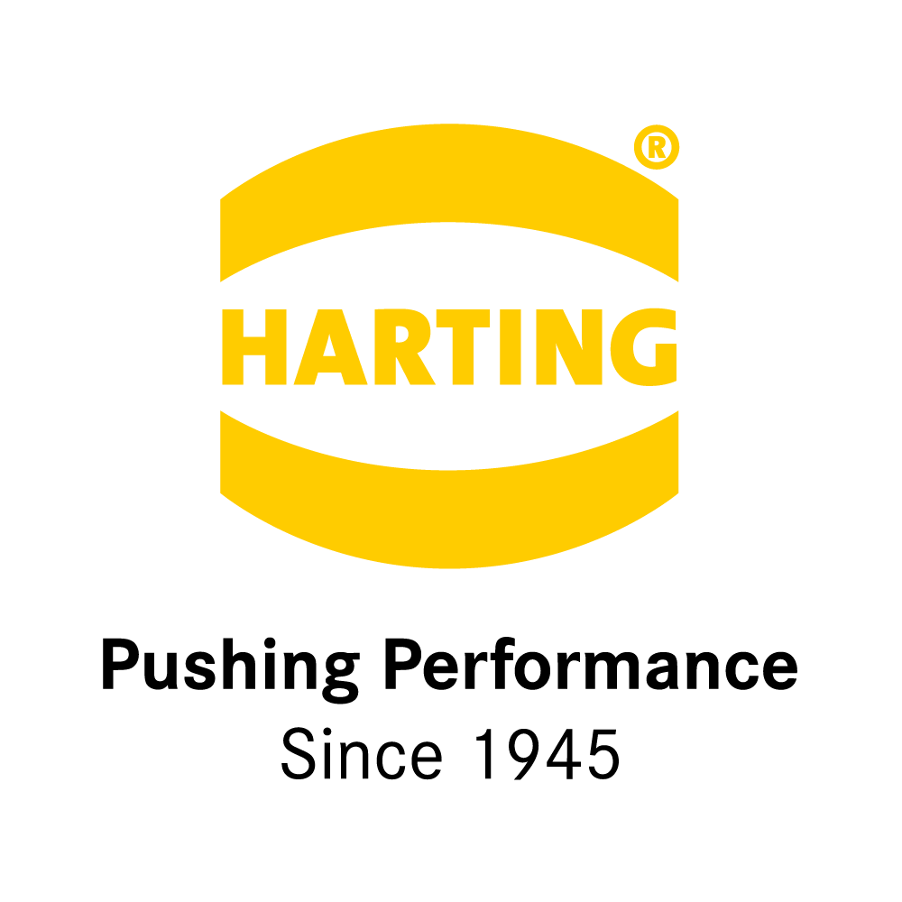
Single Pair Ethernet (SPE)
Abstract
History of ethernet connectivity in railway rolling stock equipment
What is SPE – brief history / overview of SPE in industrial connectivity
Background
Why we’re talking about SPE. Next gen of copper communication
SPE in the AAR Locomotive Consist Control (LCC) cable project to replace MU. High level discussion on solution.
Conclusion
SPE’s future in railroad rollingstock platform connectivity.
Future and value of SPE in industrial connectivity
Recommendation
More research and testing is required to understand the full implications of this topic.
Electrical Committee 2025

Slide 9
Closing

