Slide 1
LMOA MECHANICAL COMMITTEE
January 23, 2025
Frank Jalili
Chair
RailTech Consulting LLC
Patrick Roach
Vice Chair

Slide 2
THANK YOU, TOM GALLAGHER AND ENTIRE
CHEVERON ORONITE TEAM FOR HOSTING
T

Slide 3
MECHANICAL COMMITTEE STATE OF UNION

Slide 4
NO. of members – (58) Including the past presidents
New Members added – (7)
Aaron (Judd) Brown – Great Lake Central Railroad
Barry Gottschling – Power Drive
Peter Daigler – Power Drives, Inc.
William Carnegie – Wabtec
Mark Medlock – Norfolk Southern
Allen Meek Replacing Ryan Edgecomb – Cummins
Brandon Schwartz – Quality Turbocharger
Tom Shea – Quality Turbocharger has retaired
Notes:
16 Attendees for the summer meeting
Calculated that we had over 400 years of experience in the room

Slide 5
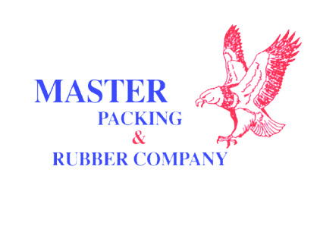
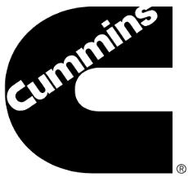
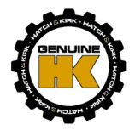
LMOA – MECHANICAL COMMITTEE
Committee Membership
58 Members
34 Different Companies
11 Different RRs
3 OEM Manufactures
2 Research Institute
7 Different Service Providers
Numerous Different Product Suppliers
Areas of Expertise
Locomotive Manufacturing
Turbo & Fuel Injection
HVAC
Research & Development
Locomotive & Component Remanufacturing
RR and Technology Consultants

Slide 6
The Committees 2024 papers
We had some fantastic papers presented by experts in their fields:
THANK YOU AGAIN:
Graciela Trillanes- HGmotive Inc. - Zero Emission on Rail...Dream or Reality
Wayne Kennedy – Kennedy Consultant - Analytical Approaches to Validating Railroad Fuel Saving Technology
Patrick Roach- Interstate Mcbee - Fuel Injector Wear and Replacement
Christopher Stoos – Southwest Research - AESS Issues and Challenges
ALL THE PAPERS ARE ARCHIVED and AVAILABLE @ LMOA WEBSITE

Slide 7
THANK YOU, TYLER AND ENTIRE ELLWOOD CRANKSHAFT TEAM FOR HOSTING, AND GIVING US THE TOUR OF THEIR FINE FACILITIES IN HERMITAGE, PA
THANK YOU, ERIC DILLEN FOR FACILIATING TOUR OF WABTEC ENGINE PLANT IN GROVE CITY, PA

Slide 8
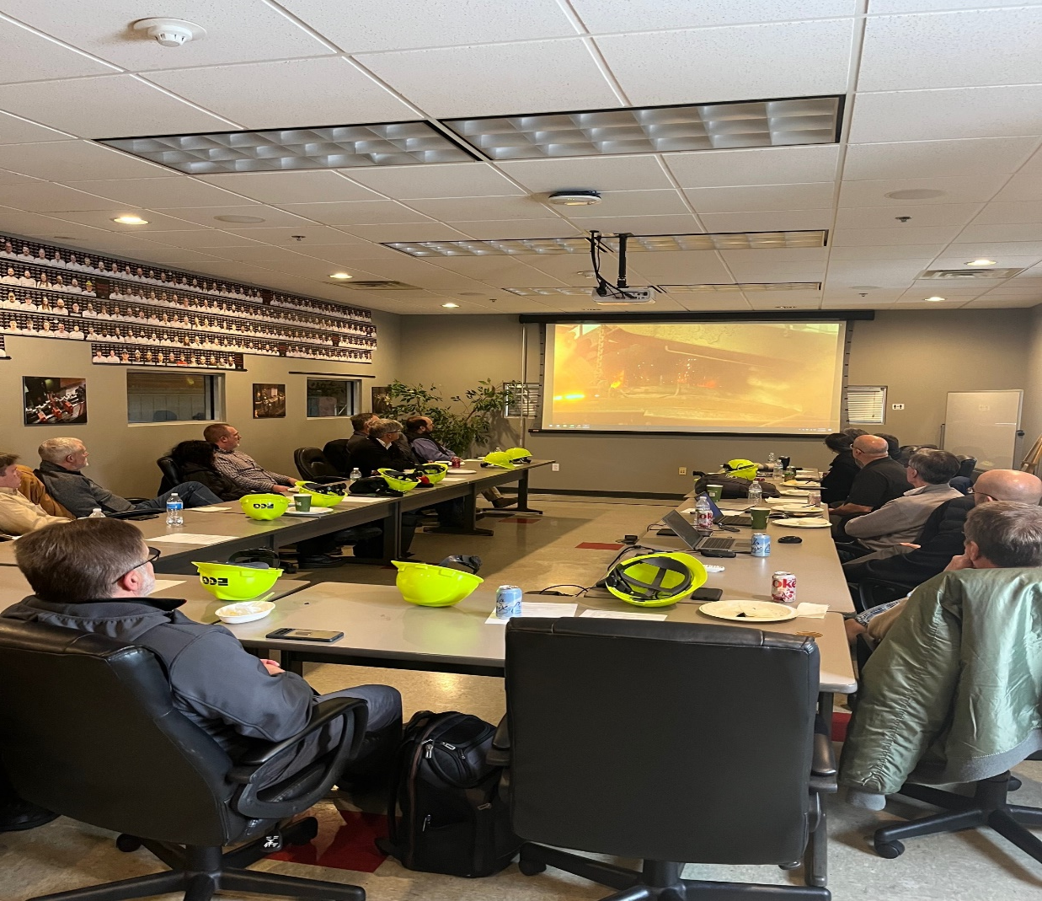
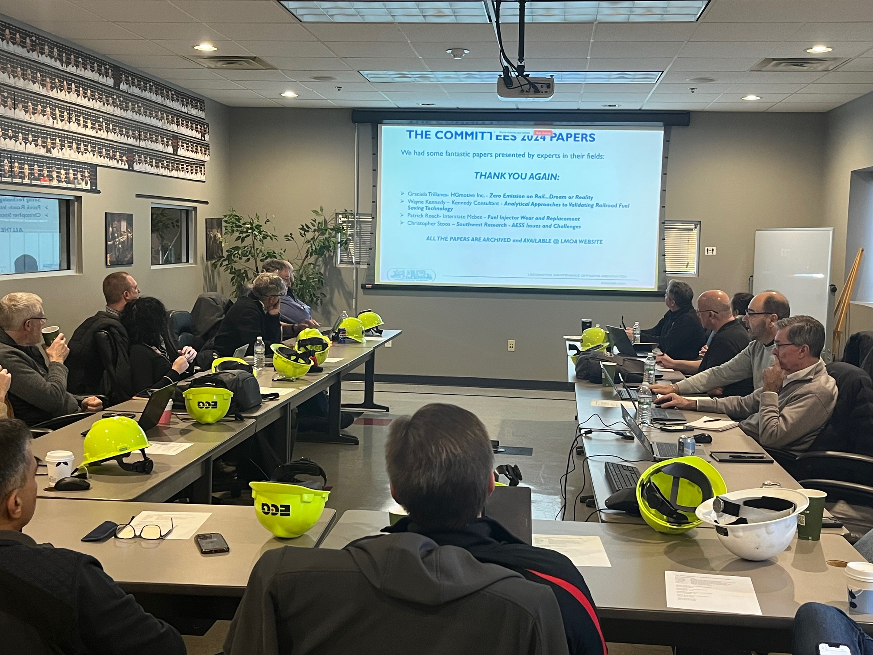

Slide 9
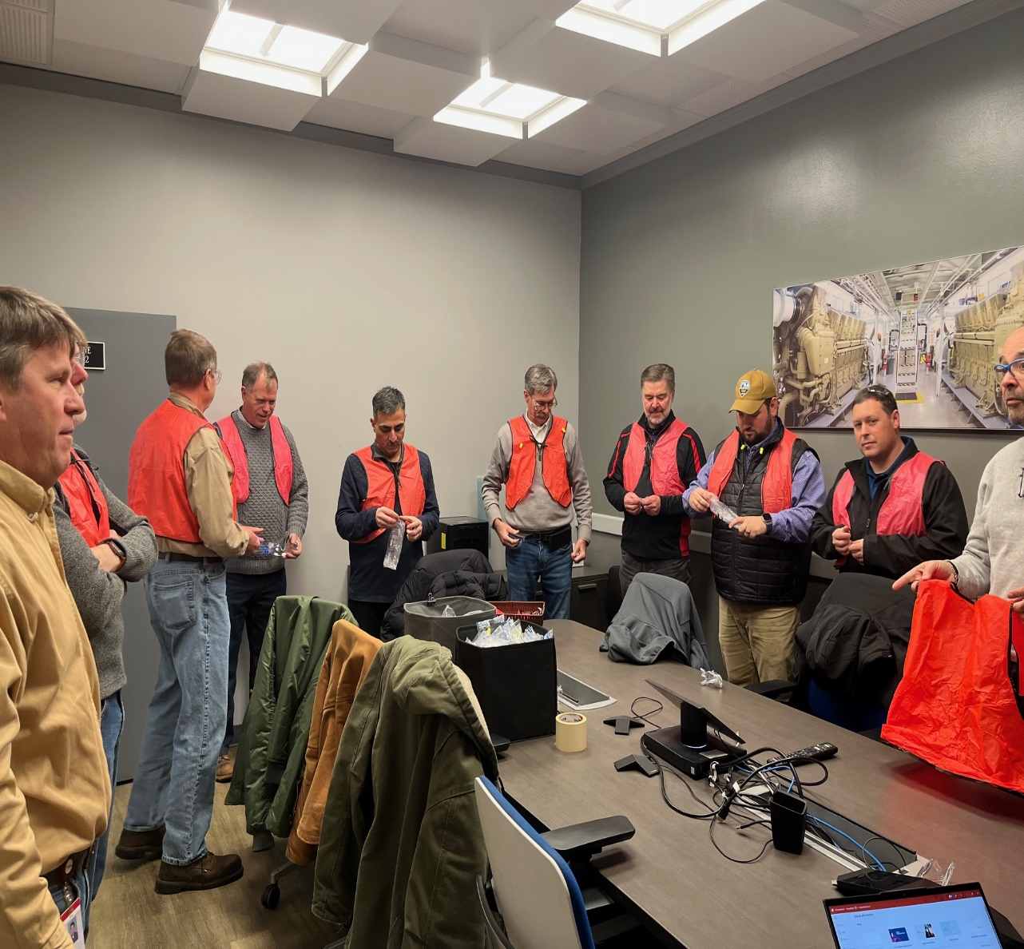
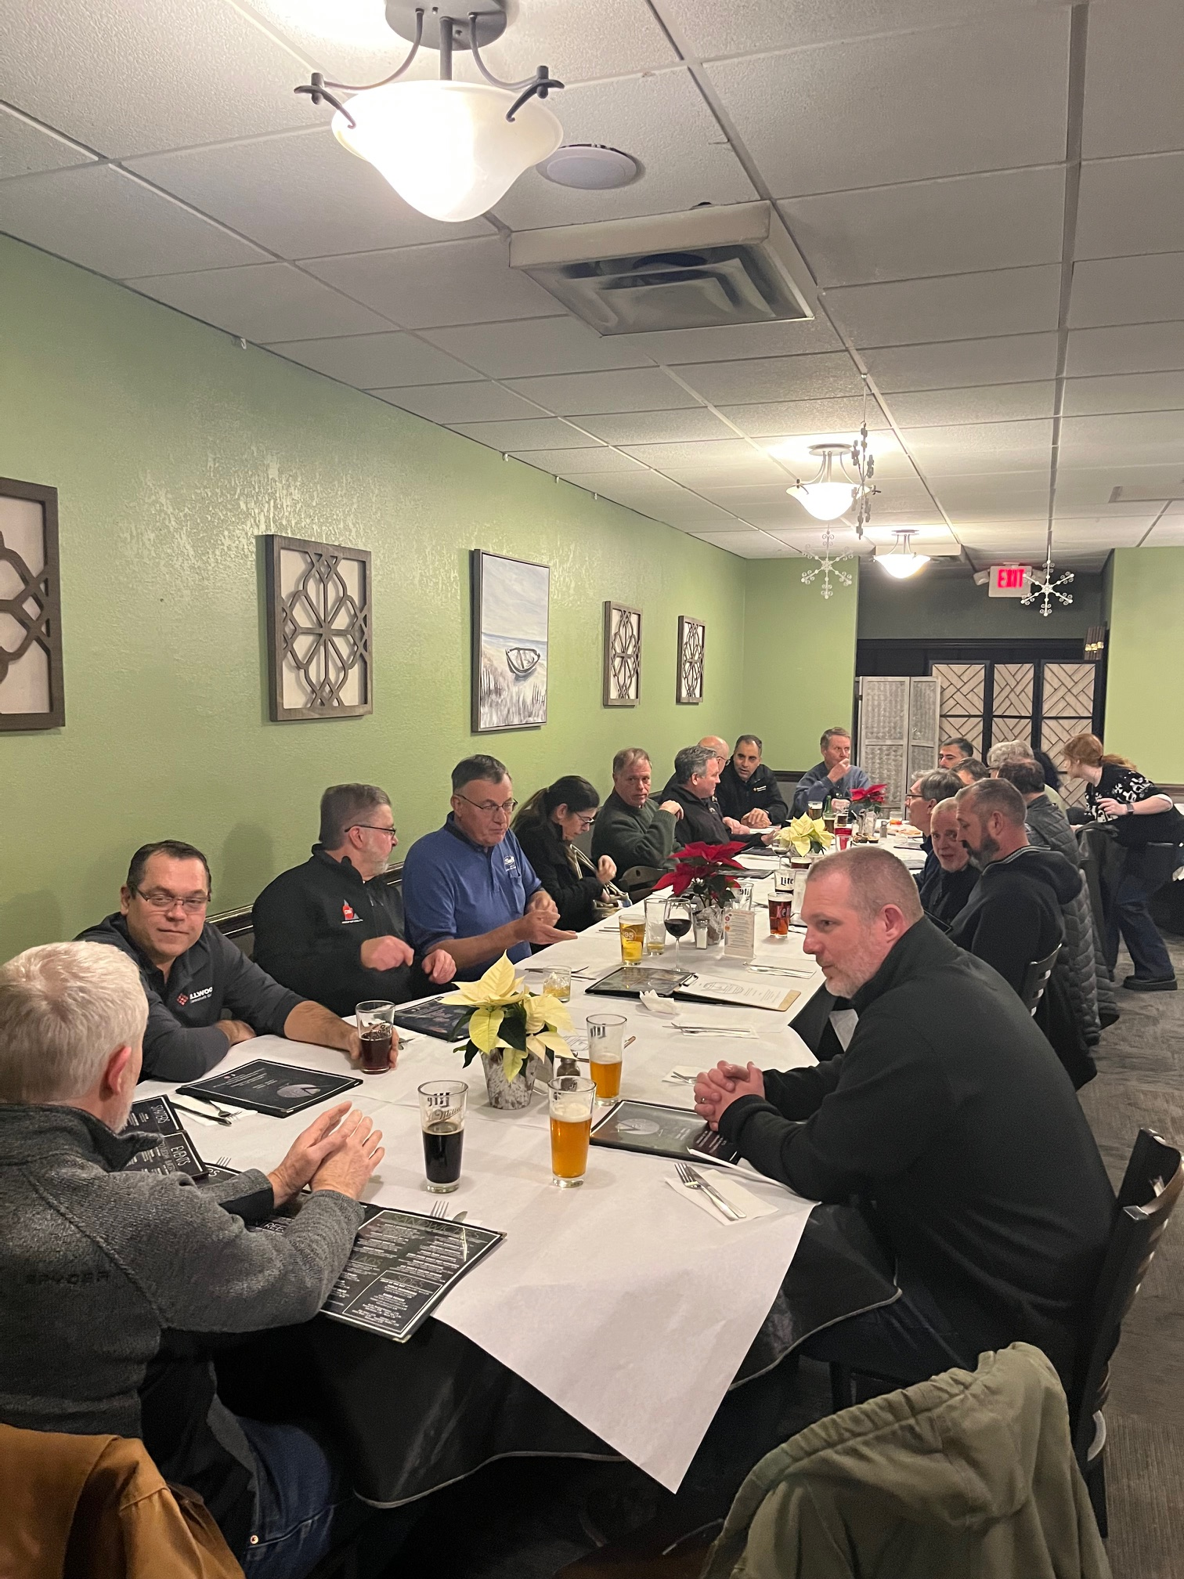

Slide 10
2025 PAPERS
Crack Monitoring on FDL16 Engine Crankshaft - Flavio Arrigoni - Progress Rail - Douglas Nunes Pereira & Geovane Erlacher Silva – erlacherbr – Vale – Presented by John Hedrick – Southwest Research
System Cleanliness (Lube Oil, Air, Water, and Fuel)-
Tim Standish - Progress Rail, Contributor - Pat Roach - Interstate McBee
Fuel Spill Protection Best Practice Update- Michael Cleveland, Peaker Services, Allen Beitel - BNSF
First Article Inspection Process Best Practice – Tom Kennedy – Kennedy Rail Consulting

Slide 11
CRACKS MONITORING ON DIESEL ENGINE CRANKSHAFT
Abstract
The use of excessive heat to assist with the removal of pipe plugs, at the end of lube oil passages in the crankshafts, caused two crankshaft failures.
A method was developed to detect cracks in the crankshaft without engine disassembly as part of a new fleet monitoring program. New fleet monitoring program:
Ranks the severity of the cracks in the crankshaft.
Leading to custom inspection intervals based on the severity of the crack(s).
No crankshaft failures have occurred since implementing monitoring program.
Background
Post several crankshaft failures in 2016: Initial fleet inspections identified 31 cracks.
Only significant cracks required crankshaft replacement.
Minor cranks are monitored for changes in crack severity, allowing additional operating time before overhaul / crankshaft replacement. Heating the lube oil passage plug during maintenance was banned.
Conclusion
Cracked crankshafts can remain operational if the cracks are minor enough and crack progression is nmonitored.
Monitoring program prevents unnecessary engine overhauls.
Crankshafts with 31 cracks remain in service.
Recommendations
Share best practices with railways.
Reassess the need for lube oil end plugs disassembly during overhauls of the crankshaft.

Slide 12
Locomotive System Cleanliness
Abstract –This paper will cover defining cleanliness, reviewing locomotive lube, fuel, intake air and water system cleanliness and go over some best practices at various stages such as manufacturing, scheduled maintenance and component change out.
Background – There are many aspects in ensuring top locomotive performance such as scheduled maintenance, proper assembly, parts made to specification, environment to name a few but one overlooked area is proper system cleanliness. While following scheduled maintenance for filter changes are key to maintaining cleanliness, there are other areas that need attention when building, repairing and performing other maintenance on locomotives and engines. Often failure modes associated with cleanliness issues are very difficult to troubleshoot as component failures can be relatively quick and catastrophic lending to difficulty for root cause analysis.
Conclusion/Recommendation – Attention to system cleanliness is often overlooked and needs to be part of all aspects of locomotive manufacturing and maintenance to avoid premature failures.

Slide 13
Fuel Spill Prevention - Allen Beitel – BNSF Railway & Michael Cleveland – Peaker Services Abstract
This paper examines locomotive fuel delivery systems, focusing on design elements, failure points, and emerging technologies. Beyond the fuel hose, considerations include drip pans, recovery systems, and the interplay between locomotive and fuel crane geometries. Common leak points—such as fuel inlets, engine components, multiple fuel ports, and piping—are analyzed alongside mitigation strategies like maintenance protocols, advanced connection technologies, and optimized fueling locations.
Advancements in fueling technology, including ultrasonic auto-shutoff systems, fuel metering, and innovative nozzle designs like dry disconnects and high-flow vacuum shutoffs, are discussed for their potential to enhance safety, efficiency, and reliability. The study concludes with recommendations for fueling operations, emphasizing proactive maintenance, tailored technology selection, and the integration of fail-safe mechanisms.

Slide 14
First Article Inspection Process Best Practice
Abstract
• First Article Inspection (FAI).
• Criteria and a process was developed to facilitate FAI’s.
Background
• Product quality of delivered products varied between units.
• Inherent defects lead to infant mortality failures and reduced durability.
Conclusion
• A consistent and thorough inspection process ensures the product is built to specifications and finds inherent defects improving quality resulting in better reliability and durability of delivered products.
• FAI’s also provide feedback to Design and Manufacturing for continuous improvement.
• FAI’s enhance product safety for operators and maintainers by finding and correcting safety issues.
Recommendations
1. Share best practices.

Slide 15
ANY QUESTIONS? SUGGESTIONS?

