Slide 1


Electrical Maintenance Committee 2025/2026 Executive Summary
Chair
Brent Brown
Vice Chair
Randy Honc

Slide 2
Electrical Maintenance Roster Update
Membership
8 Railroad
28 Supplier
36 total
Jonah Higginbotham
Notes:
In August Jonah Higginbotham joint LMOA Electrical. He brings value from past experiences with both UP and Wabtec Motive Power. Currently, Jonah is the territory manager for L&S Electric.

Slide 3
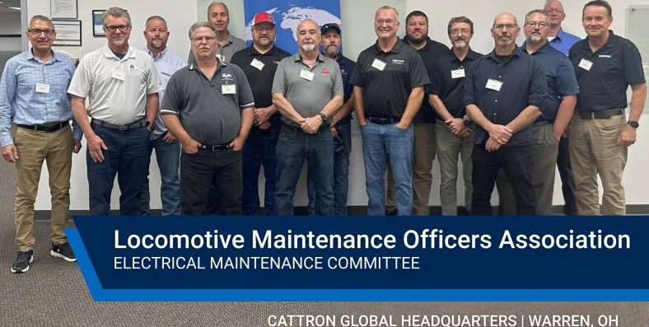

Electrical Maintenance Activities
July 29th Cattron Hosted Meeting
Locomotive remote controls enhancing yard safety and productivity.
Numerous labs/testing/simulations; Full engineering staff
Notes:
Cattron is located in Warren Ohio and produces loco controls
Jeremy Jovenall was our MVP last time.

Slide 4
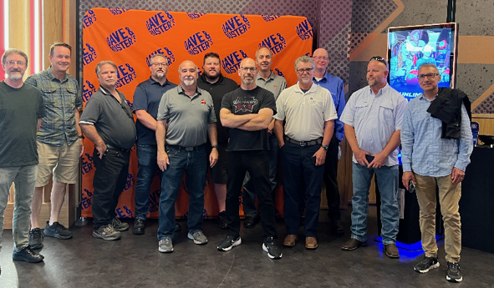
Electrical Maintenance Activities
Team Building at Dave and Buster’s

Slide 5
RSI Omaha Technical Papers
Modern Locomotive LV/HV Electrical Safety
Mike Thomason, KLW
Steve Alessandrini, CN
Contactor Control Reliability
Eric Fortin, DLL
Matt Ablett and Dan Myers, Bohr Electronics
Battery Electric & Hybrid Locomotive Solutions
David Pettengill, DPG ; Am Soora ZTR
Raul Huerta, Harting Americas
DC Motors and their use as Grid Blowers in Dynamic Braking Operations
Steve Romero, Wabtec
Rodney Myers, WLE
Notes:
Mike could not be here today so please keep him and his family in your prayers. All 3 of these are first time authors.

Slide 6
High Voltage/Low Voltage Safety in Modern Locomotive Technologies
Abstract
This paper provides high-voltage safety considerations across four key locomotive types: diesel-electric, full electric (pantograph and third rail), battery-hybrid, and hydrogen-powered locomotives.
Background
Diesel-Electric Locomotives remain essential in freight and passenger operations. High-voltage hazards in these systems arise from traction alternators, traction motors, and dynamic braking systems operating at several hundred volts. Safe work practices and protocols, high-voltage compartmentalization, and proper grounding procedures are essential to mitigate arc flash, shock, electrocution risks during maintenance and operation.
Conclusion
As the industry continues to modernize, high-voltage safety practices are essential for protecting personnel, equipment, and infrastructure.
Mike Thomason, KLW
As presented by Raul Huerta, Harting Americas

Slide 7
Contactor Control Reliability
Abstract
Analyzing frequent failures of electrical contactors and their controllers used in today’s locomotives. The industry is enhancing maintenance strategies to increase performance and ensure sustainable operational efficiency across our industry.
Background
OEM recommendations
Instruction manuals where applicable
Individual components replacement criteria
Railroad preferences
Conclusion
PM’s with condition-based monitoring is the most effective method to sustain controller and contactor reliability. Proactive inspections, timely replacement, and data-driven diagnostics reduce failures, extend component life, and secure efficient railroad operations.
Eric Fortin, DLL
As presented by Dan Myers, Bohr Electronics

Slide 8
Battery Electric & Hybrid Locomotive Solutions
Abstract
This paper presents a review of form and functionality of four different methods of locomotive electronification.
Background
A review and understanding of the different system-level solutions heading to market is needed to determine which solution best matches specific service requirements, fuels savings metrics, or environmental objectives. Battery Electric and three different configurations of Hybrid locomotives are discussed. The solutions considered offer different levels of emissions reduction, fuel savings, and mission flexibility.
Conclusion
This paper helps individuals considering new electrification technology understand the different systems coming to market, enabling more informed decision making.
David Pettengill, DPG

Slide 9
DC Motors and their use as Grid Blowers in Dynamic Braking Operations
Abstract
This paper outlines the role of DC electric motors in locomotive operations, focusing on their historical significance, technical applications, and maintenance practices. It provides a concise overview for rail industry professionals.
Background
DC motors have been integral to locomotive systems since the early 20th century, especially in diesel-electric configurations. Their ability to deliver high torque and controllable speed made them ideal for traction and auxiliary functions.
Conclusion
With proper maintenance and inspection, they offer reliable performance across diverse environmental conditions. This summary highlights their relevance and the importance of best practices in ensuring operational efficiency.
Steve Romero, Wabtec

Slide 10
Electrical Maintenance Committee 2025/2026 Executive Summary
Chair
Brent Brown
Vice Chair
Randy Honc

